Slide 1
e-VOTING MACHINE
A Project implemented using Python and Arduino..
Made By: (CSE3C)
Aman Arora (00396502716)
Arnav Choudhary(00596502716)
Anureet Kaur(35296502716)
Shivani Jadon(02396502716)
Himanshu Saini(00996502716)

Slide 2
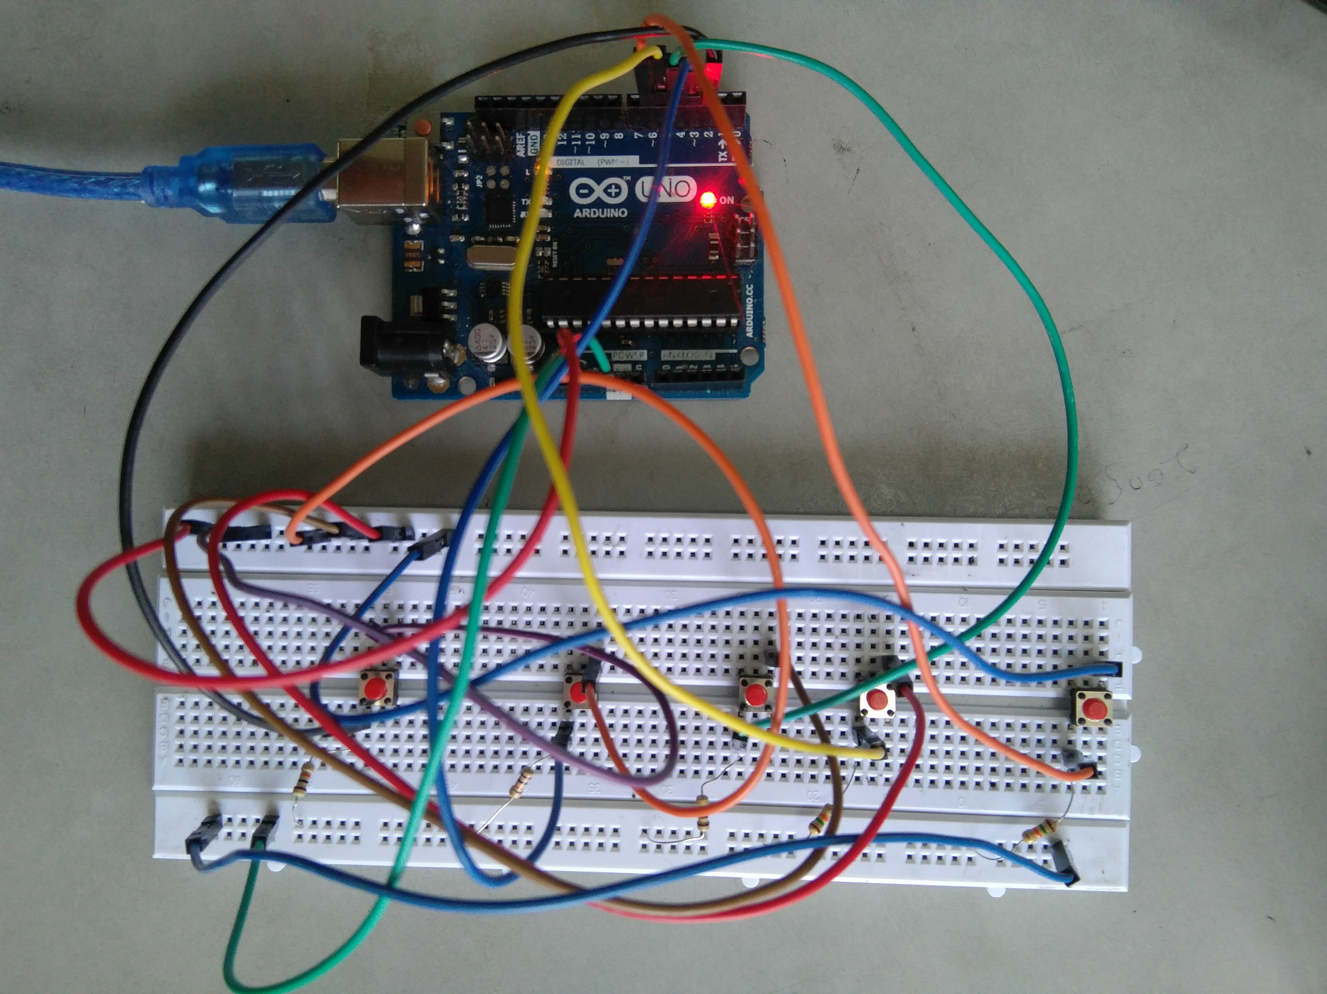
ELECTRONIC VOTING MACHINE..
Electronic Voting Machines ("EVM") are being used in Indian General and State Elections to implement electronic voting in part from 1999 elections and recently in 2017 state elections held in five states across India.

Slide 3
CONTENT
OBJECTIVE
ADVANTAGES
DESCRIPTION
WORKING

Slide 4
OBJECTIVE
Our objective is to make a user-friendly Electronic Voting Machine which makes the current voting process faster, easier and error free.
We have used Arduino in our project for implementation of push buttons and Python as a programming language.

Slide 5
ADVANTAGES
Providing the preventive measures system for voting.
It completely rules out the chance of invalid votes.
Its use results in reduction of polling time.
Results in fewer problems in electoral preparations, law and order candidates' expenditure.
Provide easy and accurate counting without any mischief at the counting centre.
It is capable of saving considerable printing stationery and transport of large volumes of electoral material.

Slide 6
DESCRIPTION
Programming Language Used : Python, C
Hardware Used : Arduino UNO
Components Used : Push buttons, Connecting Wires, Resistances(100k ohm), Breadboard
Software Used : Anaconda 2.7.x , Python 2.7.x , Arduino IDE
Modules Used : Serial , SQLite , Tkinter, tkMessageBox

Slide 7
WORKING
The user has to enter his/her ID in the system.
After verifying the user ID, the system will show a message that whether a user is eligible to vote or not after checking his/her details stored in the system.
A message will be displayed accordingly. The user will then have to press the button against which the name of the candidate is written whom he/she wants to vote.
The votes hence be stored in the database and the results will be announced accordingly.

Slide 8
THANK YOU!!

